Slide 1

Chapter 1 Introduction
A note on the use of these PowerPoint slides:
We’re making these slides freely available to all (faculty, students, readers). They’re in PowerPoint form so you see the animations; and can add, modify, and delete slides (including this one) and slide content to suit your needs. They obviously represent a lot of work on our part. In return for use, we only ask the following:
If you use these slides (e.g., in a class) that you mention their source (after all, we’d like people to use our book!)
If you post any slides on a www site, that you note that they are adapted from (or perhaps identical to) our slides, and note our copyright of this material.
For a revision history, see the slide note for this page.
Thanks and enjoy! JFK/KWR
All material copyright 1996-2020
J.F Kurose and K.W. Ross, All Rights Reserved
Computer Networking: A Top-Down Approach 8th edition Jim Kurose, Keith Ross Pearson, 2020
Notes:
Version History
7.2 (January 2020)
All slides reformatted for 16:9 aspect ratio
Use of Calibri font, rather that Gill Sans MT
Updated slide content for 2020 link technologies and applications
Add more animation throughout
New Master slide
Feb. 2020 (8.0)
a few updates suggest by Catherine Rosenberg (thanks!)
titles in a lighter font
Sept 2020 (8.1)
Added ~7 new slides, in particular: data center slide; routing versus forwarding; security line of defense; several on encapsulation and layers (this section is a lot better now). Other relative minor changes throughout

Slide 2

Chapter 1: introduction
Chapter goal:
Get “feel,” “big picture,” introduction to terminology
more depth, detail later in course
Overview/roadmap:
What is the Internet? What is a protocol?
Network edge: hosts, access network, physical media
Network core: packet/circuit switching, internet structure
Performance: loss, delay, throughput
Protocol layers, service models
Security
History

Slide 3
















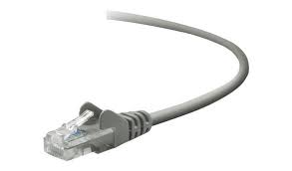
The Internet: a “nuts and bolts” view
Billions of connected computing devices:
hosts = end systems
running network apps at Internet’s “edge”
mobile network
national or global ISP
Packet switches: forward packets (chunks of data)
routers, switches
local or regional ISP
Internet
Communication links
fiber, copper, radio, satellite
transmission rate: bandwidth
home network
content
provider
network
datacenter
network
Networks
collection of devices, routers, links: managed by an organization
enterprise
network

Slide 4
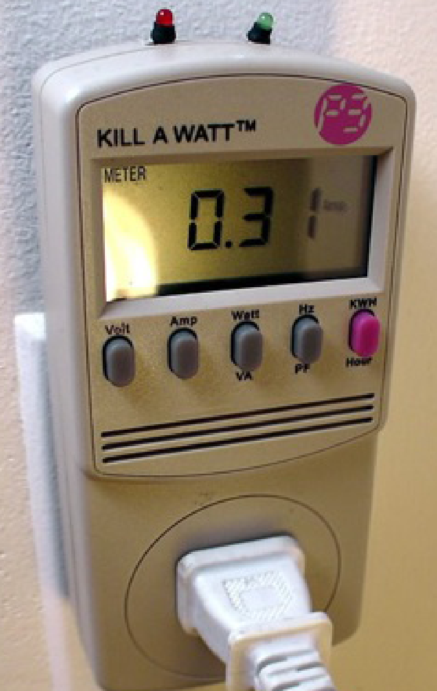

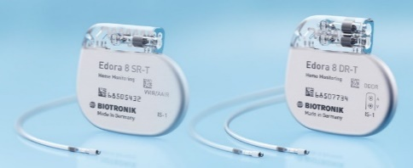





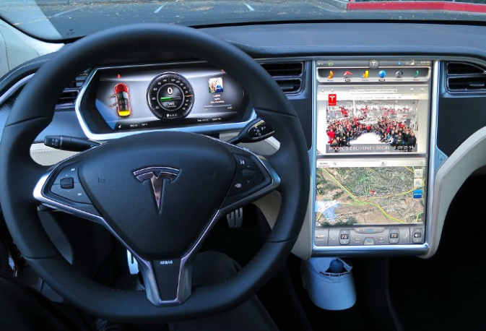



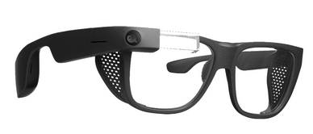

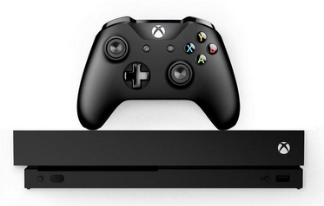

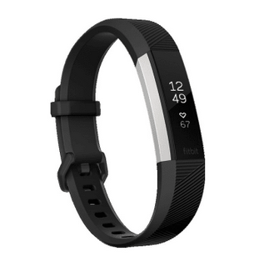
“Fun” Internet-connected devices
Tweet-a-watt:
monitor energy use
bikes
Pacemaker & Monitor
Amazon Echo
Web-enabled toaster +
weather forecaster
IP picture frame
Internet
refrigerator
Slingbox: remote
control cable TV
cars
Security Camera
AR devices
sensorized,
bed
mattress
scooters
Others?
Gaming devices
Internet phones
Fitbit

Slide 5
The Internet: a “nuts and bolts” view
mobile network
4G
Internet: “network of networks”
Interconnected ISPs
national or global ISP
protocols are everywhere
control sending, receiving of messages
e.g., HTTP (Web), streaming video, Skype, TCP, IP, WiFi, 4G, Ethernet
IP
Streaming
video
Skype
local or regional ISP
home network
content
provider
network
Internet standards
RFC: Request for Comments
IETF: Internet Engineering Task Force
HTTP
datacenter
network
Ethernet
TCP
enterprise
network
WiFi

Slide 6
The Internet: a “services” view
Infrastructure that provides services to applications:
Web, streaming video, multimedia teleconferencing, email, games, e-commerce, social media, inter-connected appliances, …
mobile network
national or global ISP
Streaming
video
Skype
local or regional ISP
provides programming interface to distributed applications:
“hooks” allowing sending/receiving apps to “connect” to, use Internet transport service
provides service options, analogous to postal service
home network
content
provider
network
HTTP
datacenter
network
enterprise
network

Slide 7
What’s a protocol?
Human protocols:
“what’s the time?”
“I have a question”
introductions
Network protocols:
computers (devices) rather than humans
all communication activity in Internet governed by protocols
Rules for:
… specific messages sent
… specific actions taken when message received, or other events
Protocols define the format, order of messages sent and received among network entities, and actions taken on message transmission, receipt

Slide 8



What’s a protocol?
A human protocol and a computer network protocol:
Hi
TCP connection
request
Hi
TCP connection
response
Got the
time?
GET http://gaia.cs.umass.edu/kurose_ross
2:00
<file>
time
Q: other human protocols?
Notes:
Explain important points
distributed entities, exchanging messages (governed by protocols)
Time going down
go over definition of protocol (showing format, order of messages sent and received, and actions taken)
We’ll see these kinds of diagrams a lot

Slide 9
Chapter 1: roadmap
What is the Internet?
What is a protocol?
Network edge: hosts, access network, physical media
Network core: packet/circuit switching, internet structure
Performance: loss, delay, throughput
Security
Protocol layers, service models
History

Slide 10
A closer look at Internet structure
mobile network
Network edge:
hosts: clients and servers
servers often in data centers
national or global ISP
local or regional ISP
home network
content
provider
network
datacenter
network
enterprise
network

Slide 11
A closer look at Internet structure
mobile network
Network edge:
hosts: clients and servers
servers often in data centers
Access networks, physical media:
wired, wireless communication links
national or global ISP
local or regional ISP
home network
content
provider
network
datacenter
network
enterprise
network

Slide 12
A closer look at Internet structure
mobile network
Network edge:
hosts: clients and servers
servers often in data centers
Access networks, physical media:
wired, wireless communication links
Network core:
interconnected routers
network of networks
national or global ISP
local or regional ISP
home network
content
provider
network
datacenter
network
enterprise
network

Slide 13
Access networks and physical media
Q: How to connect end systems to edge router?
residential access nets
institutional access networks (school, company)
mobile access networks (WiFi, 4G/5G)
mobile network
national or global ISP
local or regional ISP
home network
content
provider
network
datacenter
network
enterprise
network

Slide 14
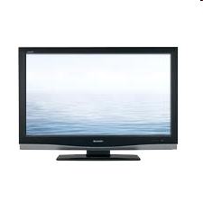


Access networks: cable-based access
cable headend
…
cable
modem
splitter
C
O
N
T
R
O
L
V
I
D
E
O
V
I
D
E
O
V
I
D
E
O
V
I
D
E
O
V
I
D
E
O
V
I
D
E
O
D
A
T
A
D
A
T
A
1
2
3
4
5
6
7
8
9
Channels
frequency division multiplexing (FDM): different channels transmitted in different frequency bands

Slide 15
Access networks: cable-based access
cable headend
…
cable
modem
splitter
CMTS
cable modem
termination system
data, TV transmitted at different
frequencies over shared cable
distribution network
ISP
HFC: hybrid fiber coax
asymmetric: up to 40 Mbps – 1.2 Gbps downstream transmission rate, 30-100 Mbps upstream transmission rate
network of cable, fiber attaches homes to ISP router
homes share access network to cable headend

Slide 16

Access networks: digital subscriber line (DSL)
central office
telephone
network
DSL
modem
splitter
DSLAM
voice, data transmitted
at different frequencies over
dedicated line to central office
ISP
DSL access
multiplexer
use existing telephone line to central office DSLAM
data over DSL phone line goes to Internet
voice over DSL phone line goes to telephone net
24-52 Mbps dedicated downstream transmission rate
3.5-16 Mbps dedicated upstream transmission rate

Slide 17







Access networks: home networks
Wireless and wired
devices
to/from headend or central office
often combined
in single box
cable or DSL modem
WiFi wireless access
point (54, 450 Mbps)
router, firewall, NAT
wired Ethernet (1 Gbps)

Slide 18








Wireless access networks
Shared wireless access network connects end system to router
via base station aka “access point”
Wide-area cellular access networks
provided by mobile, cellular network operator (10’s km)
10’s Mbps
4G cellular networks (5G coming)
Wireless local area networks (WLANs)
typically within or around building (~100 ft)
802.11b/g/n (WiFi): 11, 54, 450 Mbps transmission rate
to Internet
to Internet

Slide 19









Access networks: enterprise networks
Enterprise link to
ISP (Internet)
institutional router
Ethernet
switch
institutional mail,
web servers
companies, universities, etc.
mix of wired, wireless link technologies, connecting a mix of switches and routers (we’ll cover differences shortly)
Ethernet: wired access at 100Mbps, 1Gbps, 10Gbps
WiFi: wireless access points at 11, 54, 450 Mbps

Slide 20
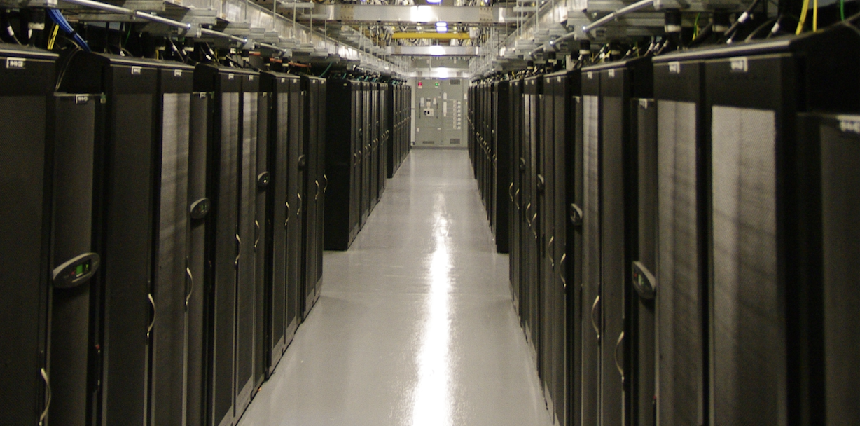
Access networks: data center networks
mobile network
high-bandwidth links (10s to 100s Gbps) connect hundreds to thousands of servers together, and to Internet
national or global ISP
local or regional ISP
home network
content
provider
network
datacenter
network
Courtesy: Massachusetts Green High Performance Computing Center (mghpcc.org)
enterprise
network

Slide 21


Host: sends packets of data
host sending function:
takes application message
breaks into smaller chunks, known as packets, of length L bits
transmits packet into access network at transmission rate R
link transmission rate, aka link capacity, aka link bandwidth
two packets,
L bits each
2
1
host
R: link transmission rate
packet
transmission
delay
time needed to
transmit L-bit
packet into link
L (bits)
R (bits/sec)
=
=

Slide 22
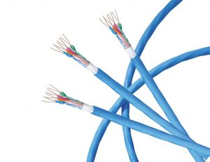
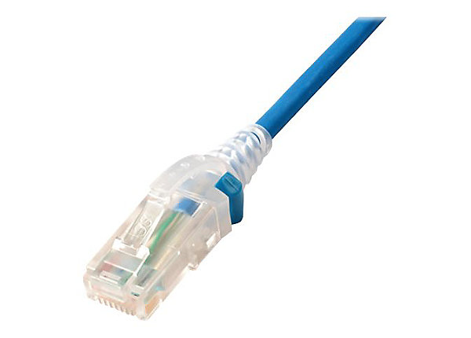
Links: physical media
bit: propagates between transmitter/receiver pairs
physical link: what lies between transmitter & receiver
guided media:
signals propagate in solid media: copper, fiber, coax
unguided media:
signals propagate freely, e.g., radio
Twisted pair (TP)
two insulated copper wires
Category 5: 100 Mbps, 1 Gbps Ethernet
Category 6: 10Gbps Ethernet

Slide 23
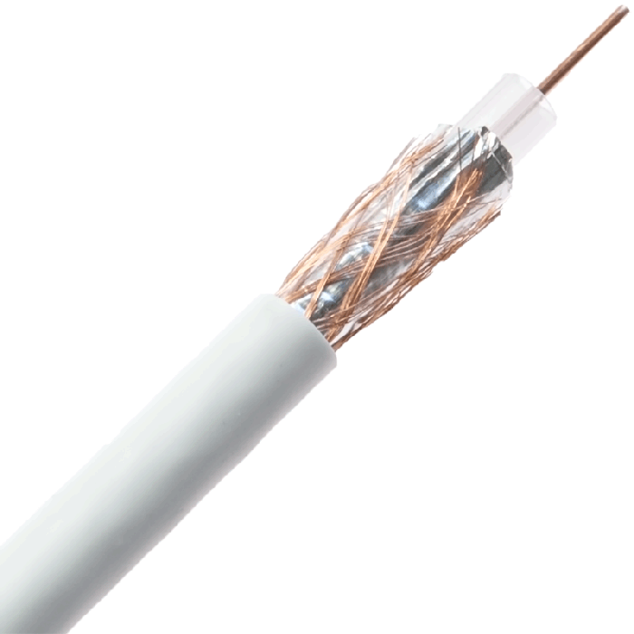
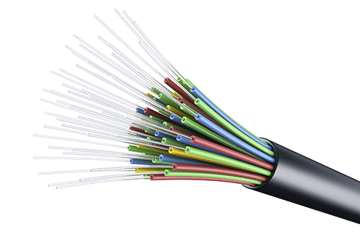
Links: physical media
Coaxial cable:
two concentric copper conductors
bidirectional
broadband:
multiple frequency channels on cable
100’s Mbps per channel
Fiber optic cable:
glass fiber carrying light pulses, each pulse a bit
high-speed operation:
high-speed point-to-point transmission (10’s-100’s Gbps)
low error rate:
repeaters spaced far apart
immune to electromagnetic noise

Slide 24
Links: physical media
Wireless radio
signal carried in various “bands” in electromagnetic spectrum
no physical “wire”
broadcast, “half-duplex” (sender to receiver)
propagation environment effects:
reflection
obstruction by objects
Interference/noise
Radio link types:
Wireless LAN (WiFi)
10-100’s Mbps; 10’s of meters
wide-area (e.g., 4G cellular)
10’s Mbps over ~10 Km
Bluetooth: cable replacement
short distances, limited rates
terrestrial microwave
point-to-point; 45 Mbps channels
satellite
up to 45 Mbps per channel
270 msec end-end delay

Slide 25
Chapter 1: roadmap
What is the Internet?
What is a protocol?
Network edge: hosts, access network, physical media
Network core: packet/circuit switching, internet structure
Performance: loss, delay, throughput
Security
Protocol layers, service models
History

Slide 26
The network core
mesh of interconnected routers
packet-switching: hosts break application-layer messages into packets
network forwards packets from one router to the next, across links on path from source to destination
mobile network
national or global ISP
local or regional ISP
home network
content
provider
network
datacenter
network
enterprise
network

Slide 27
Two key network-core functions
routing algorithm
Routing:
global action: determine source-destination paths taken by packets
routing algorithms
routing algorithm
Forwarding:
aka “switching”
local action: move arriving packets from router’s input link to appropriate router output link
local forwarding table
local forwarding table
header value
output link
0100
0101
0111
1001
3
2
2
1
1
3
2
0111
destination address in arriving
packet’s header

Slide 28
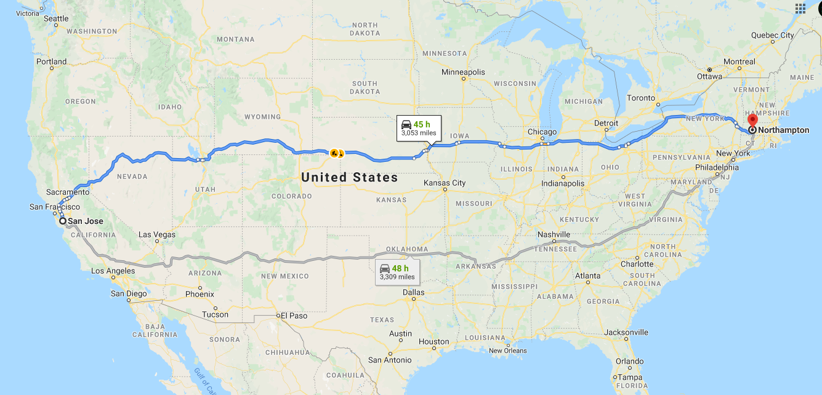
routing

Slide 29
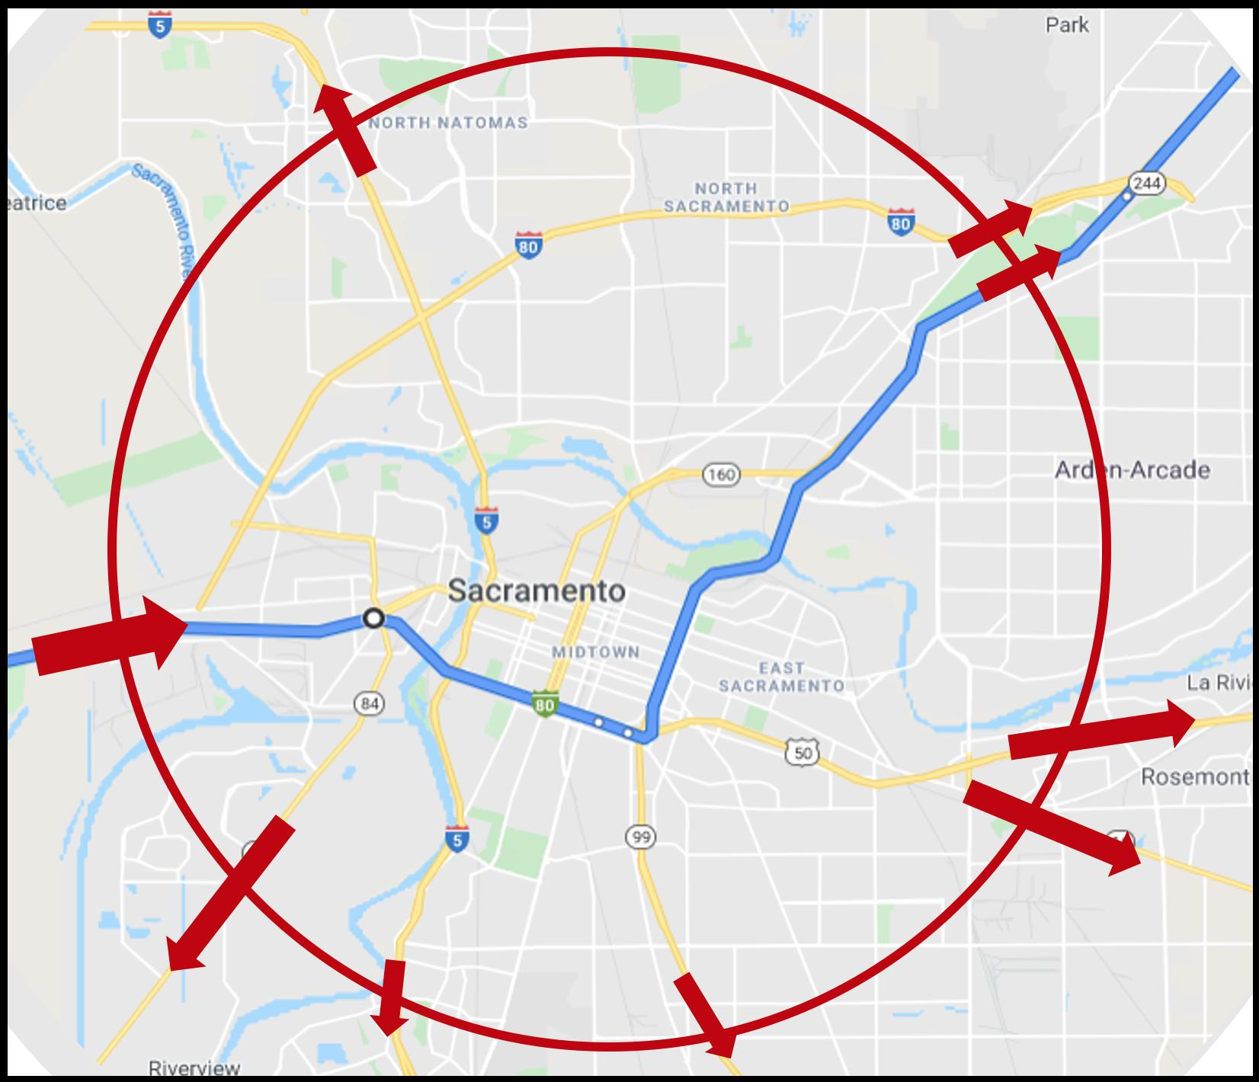
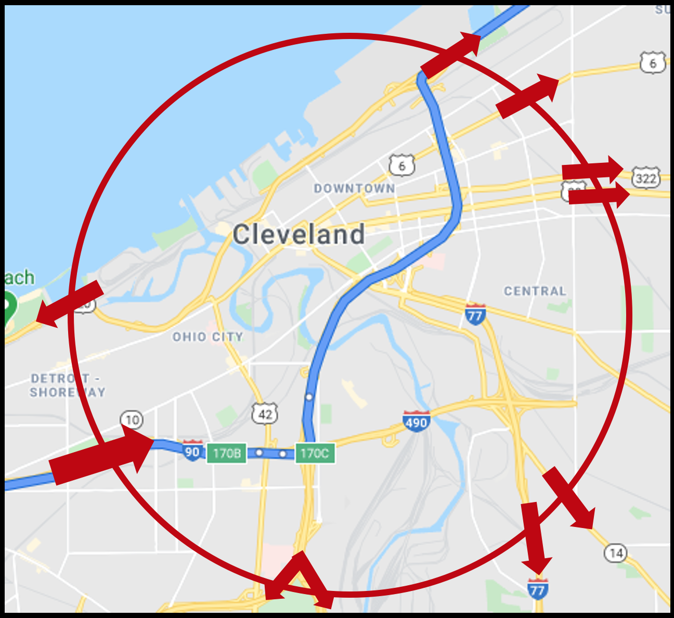
forwarding
forwarding

Slide 30



Packet-switching: store-and-forward
L bits
per packet
source
3
2
1
destination
R bps
R bps
packet transmission delay: takes L/R seconds to transmit (push out) L-bit packet into link at R bps
store and forward: entire packet must arrive at router before it can be transmitted on next link
One-hop numerical example:
L = 10 Kbits
R = 100 Mbps
one-hop transmission delay = 0.1 msec

Slide 31
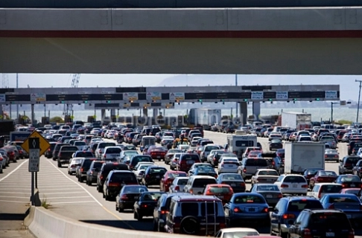
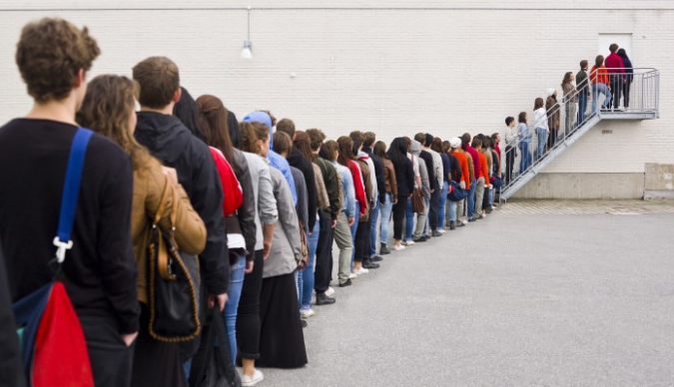
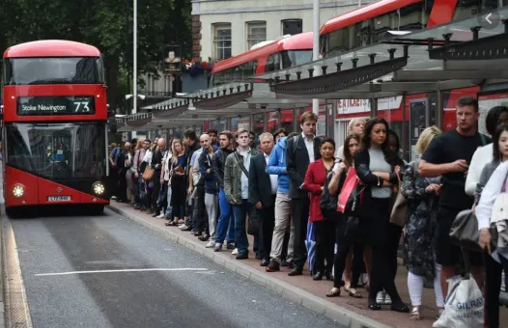
Packet-switching: queueing
R = 100 Mb/s
C
A
R = 1.5 Mb/s
D
B
E
queue of packets
waiting for transmission over output link
Queueing occurs when work arrives faster than it can be serviced:

Slide 32
Packet-switching: queueing
R = 100 Mb/s
C
A
R = 1.5 Mb/s
D
B
E
queue of packets
waiting for transmission over output link
Packet queuing and loss: if arrival rate (in bps) to link exceeds transmission rate (bps) of link for some period of time:
packets will queue, waiting to be transmitted on output link
packets can be dropped (lost) if memory (buffer) in router fills up

Slide 33
Alternative to packet switching: circuit switching
end-end resources allocated to, reserved for “call” between source and destination
in diagram, each link has four circuits.
call gets 2nd circuit in top link and 1st circuit in right link.
dedicated resources: no sharing
circuit-like (guaranteed) performance
circuit segment idle if not used by call (no sharing)
commonly used in traditional telephone networks
* Check out the online interactive exercises for more examples: http://gaia.cs.umass.edu/kurose_ross/interactive

Slide 34
Circuit switching: FDM and TDM
Frequency Division Multiplexing (FDM)
optical, electromagnetic frequencies divided into (narrow) frequency bands
4 users
frequency
each call allocated its own band, can transmit at max rate of that narrow band
time
Time Division Multiplexing (TDM)
time divided into slots
frequency
each call allocated periodic slot(s), can transmit at maximum rate of (wider) frequency band (only) during its time slot(s)
time
Notes:
FDM used in wired comm.
TDM used for wireless comm.

Slide 35
Packet switching versus circuit switching
example:
1 Gb/s link
each user:
100 Mb/s when “active”
active 10% of time
…..
N
users
1 Gbps link
Q: how many users can use this network under circuit-switching and packet switching?
circuit-switching: 10 users
packet switching: with 35 users, probability > 10 active at same time is less than .0004 *
Q: how did we get value 0.0004?
A: HW problem (for those with course in probability only)
* Check out the online interactive exercises for more examples: http://gaia.cs.umass.edu/kurose_ross/interactive

Slide 36
Solution
Assume n people in the networked system.
Let P(k) be the probability of k persons transmitting data simultaneously:
P(k) = c(n, k) * (0.1)^k * (1-0.1)^ (n-k) [select k person from n, k are transmitting while n-k are not transmitting]
The probability of no collision in the system p(no collision) =
P(0) + P(1) … + P(10) (at most 10 persons can transmit data at the same time)
Chance of collision = 1 - p(no collision)
Notes:
C(n,k) = number of ways to choose k persons out of a pool of n people. = n!/k!(n-k)!
(permutation is n!/(n-k)!)
Makes sense to add parenthesis to the formula of P(k) like this:
P(k) = c(n, k) * [ (0.1)^k * (1-0.1)^ (n-k) ]
[ (all possible (unordered) combinations of k persons out of a pool of n people) * (prob that k persons out of n people are transmitting) * (prob remaining n-k people are not transmitting)]

Slide 37
Packet switching versus circuit switching
Is packet switching a “slam dunk winner”?
great for “bursty” data – sometimes has data to send, but at other times not
resource sharing
simpler, no call setup
excessive congestion possible: packet delay and loss due to buffer overflow
protocols needed for reliable data transfer, congestion control
Q: How to provide circuit-like behavior with packet-switching?
“It’s complicated.” We’ll study various techniques that try to make packet switching as “circuit-like” as possible.
Q: human analogies of reserved resources (circuit switching) versus on-demand allocation (packet switching)?

Slide 38
Internet structure: a “network of networks”
hosts connect to Internet via access Internet Service Providers (ISPs)
access ISPs in turn must be interconnected
so that any two hosts (anywhere!) can send packets to each other
resulting network of networks is very complex
evolution driven by economics, national policies
mobile network
national or global ISP
local or regional ISP
home network
content
provider
network
datacenter
network
enterprise
network
Let’s take a stepwise approach to describe current Internet structure

Slide 39
Internet structure: a “network of networks”
Question: given millions of access ISPs, how to connect them together?
…
…
access
net
access
net
access
net
access
net
access
net
access
net
access
net
…
…
access
net
access
net
access
net
access
net
access
net
access
net
…
access
net
access
net
…
access
net

Slide 40
Internet structure: a “network of networks”
Question: given millions of access ISPs, how to connect them together?
…
…
access
net
access
net
access
net
access
net
access
net
…
…
access
net
access
net
connecting each access ISP to each other directly doesn’t scale: O(N²) connections.
…
…
…
access
net
access
net
…
access
net
access
net
access
net
…
access
net
…
access
net
access
net
…
access
net

Slide 41
Internet structure: a “network of networks”
Option: connect each access ISP to one global transit ISP?
Customer and provider ISPs have economic agreement.
…
…
access
net
access
net
access
net
access
net
access
net
access
net
access
net
…
…
global ISP
access
net
access
net
access
net
access
net
access
net
access
net
…
access
net
access
net
…
access
net

Slide 42
Internet structure: a “network of networks”
But if one global ISP is viable business, there will be competitors ….
…
…
access
net
access
net
access
net
access
net
access
net
access
net
ISP A
access
net
…
…
access
net
ISP B
access
net
ISP C
access
net
access
net
access
net
access
net
…
access
net
access
net
…
access
net

Slide 43
Internet structure: a “network of networks”
But if one global ISP is viable business, there will be competitors …. who will want to be connected
Internet exchange point
…
…
access
net
access
net
access
net
access
net
access
net
IXP
access
net
access
net
ISP A
…
…
access
net
IXP
ISP B
access
net
ISP C
access
net
access
net
peering link
access
net
access
net
…
access
net
access
net
…
access
net

Slide 44
Internet structure: a “network of networks”
… and regional networks may arise to connect access nets to ISPs
…
…
access
net
access
net
access
net
access
net
access
net
IXP
access
net
access
net
ISP A
…
…
access
net
IXP
ISP B
access
net
ISP C
access
net
access
net
access
net
regional ISP
access
net
…
access
net
access
net
…
access
net

Slide 45
Internet structure: a “network of networks”
… and content provider networks (e.g., Google, Microsoft, Akamai) may run their own network, to bring services, content close to end users
…
…
access
net
access
net
access
net
access
net
access
net
IXP
access
net
access
net
ISP A
…
…
Content provider network
access
net
IXP
ISP B
access
net
ISP C
access
net
access
net
access
net
regional ISP
access
net
…
access
net
access
net
…
access
net

Slide 46
Internet structure: a “network of networks”
Tier 1 ISP
Tier 1 ISP
Google
IXP
IXP
IXP
Regional ISP
Regional ISP
access
ISP
access
ISP
access
ISP
access
ISP
access
ISP
access
ISP
access
ISP
access
ISP
At “center”: small # of well-connected large networks
“tier-1” commercial ISPs (e.g., Level 3, Sprint, AT&T, NTT), national & international coverage
content provider networks (e.g., Google, Facebook): private network that connects its data centers to Internet, often bypassing tier-1, regional ISPs

Slide 47
Chapter 1: roadmap
What is the Internet?
What is a protocol?
Network edge: hosts, access network, physical media
Network core: packet/circuit switching, internet structure
Performance: loss, delay, throughput
Security
Protocol layers, service models
History

Slide 48
How do packet delay and loss occur?
packets queue in router buffers, waiting for turn for transmission
queue length grows when arrival rate to link (temporarily) exceeds output link capacity
packet loss occurs when memory to hold queued packets fills up
packet being transmitted (transmission delay)
A
B
packets in buffers (queueing delay)
free (available) buffers: arriving packets
dropped (loss) if no free buffers

Slide 49
Packet delay: four sources
transmission
A
propagation
B
nodal
processing
queueing
d_{nodal} = d_{proc} + d_{queue} + d_{trans} + d_{prop}
d_{proc}: nodal processing
check bit errors
determine output link
typically < microsecs
d_{queue}: queueing delay
time waiting at output link for transmission
depends on congestion level of router

Slide 50
Packet delay: four sources
transmission
A
propagation
B
nodal
processing
queueing
d_{nodal} = d_{proc} + d_{queue} + d_{trans} + d_{prop}
d_{trans}: transmission delay:
L: packet length (bits)
R: link transmission rate (bps)
d_{trans} = L/R
d_{prop}: propagation delay:
d: length of physical link
s: propagation speed (~2x10⁸ m/sec)
d_{prop} = d/s
d_{trans} and d_{prop}
very different
Notes:
Transmission delay: dictated by interface cards→ time it takes a digital bit signal to be converted to analog bit signal (high and low voltage pulses over a medium).

Slide 51

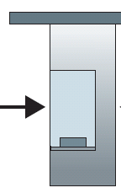
Caravan analogy
100 km
100 km
ten-car caravan
(aka 10-bit packet)
toll booth
toll booth
toll booth
(aka link)
toll booth
toll booth
(aka link)
car ~ bit; caravan ~ packet; toll service ~ link transmission
toll booth takes 12 sec to service car (bit transmission time)
“propagate” at 100 km/hr
Q: How long until caravan is lined up before 2nd toll booth?
time to “push” entire caravan through toll booth onto highway = 12*10 = 120 sec
time for last car to propagate from 1st to 2nd toll both: 100km/(100km/hr) = 1 hr
A: 62 minutes
Notes:
Note: for analogy: each car represents a bit; all cars together represent a packet = 1 10-bit packet in this analogy.

Slide 52

Caravan analogy
100 km
100 km
ten-car caravan
(aka 10-bit packet)
toll booth
(aka router)
toll booth
suppose cars now “propagate” at 1000 km/hr
and suppose toll booth now takes one min to service a car
Q: Will cars arrive to 2nd booth before all cars serviced at first booth?
A: Yes! after 7 min, first car arrives at second booth; three cars still at first booth

Slide 53

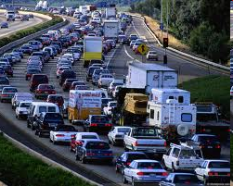
Packet queueing delay (revisited)
a: average packet arrival rate
L: packet length (bits)
R: link bandwidth (bit transmission rate)
average queueing delay
L
a
.
:
arrival rate of bits
“traffic
intensity”
R
service rate of bits
traffic intensity = La/R
1
La/R ~ 0: avg. queueing delay small
La/R -> 1: avg. queueing delay large
La/R > 1: more “work” arriving is more than can be serviced - average delay infinite!
La/R ~ 0
La/R -> 1
Notes:
Network cards bring transmission delay: how fast can the network interface card translate digital to analog high-low voltage signals?

Slide 54
“Real” Internet delays and routes
what do “real” Internet delay & loss look like?
traceroute program: provides delay measurement from source to router along end-end Internet path towards destination. For all i:
sends three packets that will reach router i on path towards destination (with time-to-live field value of i)
router i will return packets to sender
sender measures time interval between transmission and reply
3 probes
3 probes
3 probes

Slide 55
Real Internet delays and routes
traceroute: gaia.cs.umass.edu to www.eurecom.fr
3 delay measurements from
gaia.cs.umass.edu to cs-gw.cs.umass.edu
1 cs-gw (128.119.240.254) 1 ms 1 ms 2 ms
2 border1-rt-fa5-1-0.gw.umass.edu (128.119.3.145) 1 ms 1 ms 2 ms
3 cht-vbns.gw.umass.edu (128.119.3.130) 6 ms 5 ms 5 ms
4 jn1-at1-0-0-19.wor.vbns.net (204.147.132.129) 16 ms 11 ms 13 ms
5 jn1-so7-0-0-0.wae.vbns.net (204.147.136.136) 21 ms 18 ms 18 ms
6 abilene-vbns.abilene.ucaid.edu (198.32.11.9) 22 ms 18 ms 22 ms
7 nycm-wash.abilene.ucaid.edu (198.32.8.46) 22 ms 22 ms 22 ms
8 62.40.103.253 (62.40.103.253) 104 ms 109 ms 106 ms
9 de2-1.de1.de.geant.net (62.40.96.129) 109 ms 102 ms 104 ms
10 de.fr1.fr.geant.net (62.40.96.50) 113 ms 121 ms 114 ms
11 renater-gw.fr1.fr.geant.net (62.40.103.54) 112 ms 114 ms 112 ms
12 nio-n2.cssi.renater.fr (193.51.206.13) 111 ms 114 ms 116 ms
13 nice.cssi.renater.fr (195.220.98.102) 123 ms 125 ms 124 ms
14 r3t2-nice.cssi.renater.fr (195.220.98.110) 126 ms 126 ms 124 ms
15 eurecom-valbonne.r3t2.ft.net (193.48.50.54) 135 ms 128 ms 133 ms
16 194.214.211.25 (194.214.211.25) 126 ms 128 ms 126 ms
17 * * *
18 * * *
19 fantasia.eurecom.fr (193.55.113.142) 132 ms 128 ms 136 ms
3 delay measurements
to border1-rt-fa5-1-0.gw.umass.edu
trans-oceanic link
looks like delays decrease! Why?
* means no response (probe lost, router not replying)
* Do some traceroutes from exotic countries at www.traceroute.org
Notes:
We can use tracert command on windows cmd (stands for “trace route”)
You can use WHOIS lookup service (lookup.icann.org) to find out the owner of an IP address.

Slide 56
Packet loss
queue (aka buffer) preceding link in buffer has finite capacity
packet arriving to full queue dropped (aka lost)
lost packet may be retransmitted by previous node, by source end system, or not at all
buffer
(waiting area)
A
packet being transmitted
B
packet arriving to
full buffer is lost
* Check out the Java applet for an interactive animation (on publisher’s website) of queuing and loss
Notes:
Packet loss happens quite often
TCP actually has this built into the algorithm in order to avoid congestion on the network.

Slide 57
Throughput
throughput: rate (bits/time unit) at which bits are being sent from sender to receiver
instantaneous: rate at given point in time
average: rate over longer period of time
link capacity
R_{s} bits/sec
link capacity
R_{c} bits/sec
pipe that can carry
fluid at rate
(R_{s} bits/sec)
pipe that can carry
fluid at rate
(R_{c} bits/sec)
server sends bits
(fluid) into pipe
server, with
file of F bits
to send to client
Notes:
Bandwidth is a physical throughput limitation; throughput is a physical AND logical/system model design limitation of bits/sec output.
Remember: the weakest link is the biggest constraint of throughput for a system.

Slide 58
Throughput
R_{s} < R_{c} What is average end-end throughput?
R_{s} bits/sec
R_{c} bits/sec
R_{s} > R_{c} What is average end-end throughput?
R_{s} bits/sec
R_{c} bits/sec
bottleneck link
link on end-end path that constrains end-end throughput

Slide 59
Throughput: network scenario
per-connection end-end throughput: min(R_{c},R_{s},R/10)
in practice: R_{c} or R_{s} is often bottleneck
R_{s}
R_{s}
R_{s}
R
R_{c}
R_{c}
R_{c}
* Check out the online interactive exercises for more examples: http://gaia.cs.umass.edu/kurose_ross/
10 connections (fairly) share backbone bottleneck link R bits/sec

Slide 60
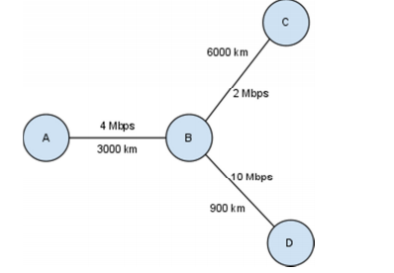
Propagation speed: 3*10^8 m/s
transmission delay of:
A sends a 500 byte packet to B
B sends a 125 byte packet to D
The propagation delay between A and B, B and D
A wants to send a 500 byte packet to D through B. B is supposed to follow the store-and-forward model (B will receive the whole packet from A and then start transmitting the packet to D). What is the end-to-end delay seen by the packet?
Now, A wants to send a 5 MB file to D in chunks of 500 byte packets. To prevent any packet loss, when A sends a 500 byte packet to D (same way as explained in (c)), D responds with a 50 byte packet to A (through B) acknowledging that it has successfully received the packet. Only after receiving the acknowledgement does A send the next 500 byte packet. Assuming no losses, how long will it take A to send the file to D?
What is the throughput of this application? What is the throughput of the communication system between A and D? What is the link utilization?
Note: we do not count the ack message as part of data for calculating throughput.
Notes:
*note: For example, Mbps = transmission speed = speed at which digital bits get converted into analog (high-low voltages) bits and pushed onto the link.
-do not get link transmission speed confused with propagation speed, which depends on speed of light and the medium in which that light is travelling.
*store and forward model: receive entire packet before beginning transmitting it to the next hop.
Speed of the light: 3 times 10 to the power of 8.
Q1: Transmission Delay = Size of Transfer / Link Bandwidth
A B: Transmission Delay = (500/ ((4/8) x 10^6 )) = 1ms
B D: Transmission Delay = (125/ (10/8) x 10^6 ) = 0.1ms
Q2: Propagation Delay = Distance of link / propagation
A B: Propagation Delay = 3000 / (3 x 10^5 ) = 10ms
B D: Propagation Delay = 900 / (3 x 10^5 ) = 3ms
Q3: End to end delay between A and D = (Delay between AB) + (Delay between BD)
Delay on a link = Transmission Delay + Propagation Delay
Therefore, Delay between AB = 1 + 10 = 11ms,
and Delay between BD = 0.4 + 3 = 3.4ms
End to end delay between AD = 11ms + 3.4ms = 14.4ms
Q4: End to end delay between AD for a 500 byte packet = 14.4ms
End to end delay between AD for a 50 byte ACK = (0.1 + 10) + (0.04 + 3) = 13.14ms
Total delay for a packet and ACK = 14.4 + 13.14 = 27.54ms
#packets in a 5MB transfer = (5 x 106 ) / 500 = 10,000
herefore, total time for transfer = 10000 x 27.54ms = 275.4 sec
Q5: throughput, 5MB/275 seconds = 18KBps = 144 Kbps
Throughput of a communication system, it means the physical features of the path. Has nothing to do with how the communication between the sender and receivers is designed. Or you can see it as if the sender is sending at full speed, what is the maximum throughput.
0.144 Mbps / 4Mbps = 3.6%

Slide 61
Q1: Transmission Delay = Size of Transfer / Link Bandwidth
A B: Transmission Delay = (500/ ((4/8) x 10^6 )) = 1ms
B D: Transmission Delay = (125/ (10/8) x 10^6 ) = 0.1ms
Q2: Propagation Delay = Distance of link / propagation
A B: Propagation Delay = 3000 / (3 x 10^5 ) = 10ms
B D: Propagation Delay = 900 / (3 x 10^5 ) = 3ms
Q3: End to end delay between A and D = (Delay between AB) + (Delay between BD)
Delay on a link = Transmission Delay + Propagation Delay
Therefore, Delay between AB = 1 + 10 = 11ms,
and Delay between BD = 0.4 + 3 = 3.4ms
End to end delay between AD = 11ms + 3.4ms = 14.4ms
Q4: End to end delay between AD for a 500 byte packet = 14.4ms
End to end delay between AD for a 50 byte ACK = (0.1 + 10) + (0.04 + 3) = 13.14ms
Total delay for a packet and ACK = 14.4 + 13.14 = 27.54ms
#packets in a 5MB transfer = (5 x 106 ) / 500 = 10,000
herefore, total time for transfer = 10000 x 27.54ms = 275.4 sec
Q5: throughput, 5MB/275 seconds = 18KBps = 144 Kbps
Throughput of a communication system, it means the physical features of the path. Has nothing to do with how the communication between the sender and receivers is designed. Or you can see it as if the sender is sending at full speed, what is the maximum throughput.
0.144 Mbps / 4Mbps = 3.6%
Notes:
Note: for speed of light he uses KM = 3x10^5 km/s

Slide 62
How to evaluate the performance of a distributed system?
Metrics (QoS, quality of service):
Throughput,
Latency,
Cost,
Reliability,
worst case latency,
Energy efficiency,
Security
…
Notes:
We don’t usually have numeric measurement of how ``reliable’’ a system is…
Instead we say the system is robust to: events/SPOF/…
Note: we sacrifice throughput for reliability by using ack messages (and thus breaking up data into packets and doing periodic acknowledgments of their reception).

Slide 63
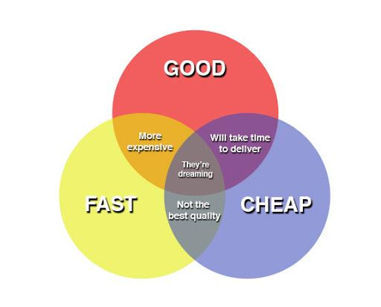
NO system is perfect
it is always about tradeoffs.
Notes:
Notice there is always a tradeoff

Slide 64
Chapter 1: roadmap
What is the Internet?
What is a protocol?
Network edge: hosts, access network, physical media
Network core: packet/circuit switching, internet structure
Performance: loss, delay, throughput
Security
Protocol layers, service models
History
Notes:
Segue: from performance to security

Slide 65
Network security
Internet not originally designed with (much) security in mind
original vision: “a group of mutually trusting users attached to a transparent network” ☺
Internet protocol designers playing “catch-up”
security considerations in all layers!
We now need to think about:
how bad guys can attack computer networks
how we can defend networks against attacks
how to design architectures that are immune to attacks
Notes:
Internet was not initially designed with security in mind.

Slide 66


Bad guys: packet interception
packet “sniffing”:
broadcast media (shared Ethernet, wireless)
promiscuous network interface reads/records all packets (e.g., including passwords!) passing by
A
C
src:B dest:A payload
B
Wireshark software used for our end-of-chapter labs is a (free) packet-sniffer
Notes:
Packet sniff: listening on a network
No need to decode the message; but to know what kind of traffic and when it is being transmitted in a network

Slide 67
Bad guys: fake identity
IP spoofing: injection of packet with false source address
A
C
src:B dest:A payload
B
Notes:
Snoop= pretend to be someone else

Slide 68
Bad guys: denial of service
Denial of Service (DoS): attackers make resources (server, bandwidth) unavailable to legitimate traffic by overwhelming resource with bogus traffic
1. select target
2. break into hosts around the network (see botnet)
3. send packets to target from compromised hosts
target

Slide 69
Lines of defense:
authentication: proving you are who you say you are
cellular networks provides hardware identity via SIM card; no such hardware assist in traditional Internet
confidentiality: via encryption
integrity checks: digital signatures prevent/detect tampering
access restrictions: password-protected VPNs
firewalls: specialized “middleboxes” in access and core networks:
off-by-default: filter incoming packets to restrict senders, receivers, applications
detecting/reacting to DOS attacks
… lots more on security (throughout, Chapter 8)

Slide 70
Chapter 1: roadmap
What is the Internet?
What is a protocol?
Network edge: hosts, access network, physical media
Network core: packet/circuit switching, internet structure
Performance: loss, delay, throughput
Security
Protocol layers, service models
History

Slide 71
Protocol “layers” and reference models
Networks are complex,
with many “pieces”:
hosts
routers
links of various media
applications
protocols
hardware, software
Question: is there any hope of organizing structure of network?
and/or our discussion of networks?
Notes:
Henry Ford help improve productivity with the assembly line invention because it segmented/layered the tasks so that each layer only worried about some specific task (divide and conquer and specialization).

Slide 72

Example: organization of air travel
end-to-end transfer of person plus baggage
ticket (purchase)
baggage (check)
gates (load)
runway takeoff
airplane routing
ticket (complain)
baggage (claim)
gates (unload)
runway landing
airplane routing
airplane routing
How would you define/discuss the system of airline travel?
a series of steps, involving many services

Slide 73
Example: organization of air travel
ticket (purchase)
baggage (check)
gates (load)
runway takeoff
airplane routing
ticketing service
ticket (complain)
baggage (claim)
gates (unload)
runway landing
airplane routing
baggage service
gate service
runway service
routing service
airplane routing
layers: each layer implements a service
via its own internal-layer actions
relying on services provided by layer below

Slide 74
Why layering?
Approach to designing/discussing complex systems:
explicit structure allows identification, relationship of system’s pieces
layered reference model for discussion
modularization eases maintenance, updating of system
change in layer's service implementation: transparent to rest of system
e.g., change in gate procedure doesn’t affect rest of system
Notes:
Goal: each layer relies on the abstraction of the layers below it and does not have to care about how it works and can work mostly from its own framework.

Slide 75
Layered Internet protocol stack
application: supporting network applications
HTTP, IMAP, SMTP, DNS
transport: process-process data transfer
TCP, UDP
network: routing of datagrams from source to destination
IP, routing protocols
link: data transfer between neighboring network elements
Ethernet, 802.11 (WiFi), PPP
physical: bits “on the wire”
application
application
transport
transport
network
network
link
link
physical
physical
Notes:
Link layer: makes sure data can be transmitted effectively between two devices: manages 1 hop communication basis (switching) – handles transmission (translation from digital to analog).
Network layer: makes sure data transmitted effectively between devices on a many-hop basis (routing).
Transport layer manages end-to-end communications.
OSI model is not practical; it was used as a reference for thinking about computer networks; but we no longer use that because in practice some of the layers were combined (for example presentation and session are done in the application layer now).

Slide 76
Services, Layering and Encapsulation
application
transport
network
link
physical
M
application
transport
network
link
physical
Application exchanges messages to implement some application service using services of transport layer
H_{t}
M
Transport-layer protocol transfers M (e.g., reliably) from one process to another, using services of network layer
transport-layer protocol encapsulates application-layer message, M, with transport layer-layer header H_{t} to create a transport-layer segment
H_{t} used by transport layer protocol to implement its service
source
destination
Notes:
Notice, each layer uses services of the layer below it.
Transport layer: data is referred to as “segments”.

Slide 77
Services, Layering and Encapsulation
application
transport
network
link
physical
M
application
transport
network
link
physical
H_{t}
M
Transport-layer protocol transfers M (e.g., reliably) from one process to another, using services of network layer
H_{n}
H_{t}
M
Network-layer protocol transfers transport-layer segment [H_{t} | M] from one host to another, using link layer services
network-layer protocol encapsulates transport-layer segment [H_{t} | M] with network layer-layer header H_{n} to create a network-layer datagram
H_{n} used by network layer protocol to implement its service
source
destination

Slide 78
Services, Layering and Encapsulation
H_{n}
H_{t}
M
application
transport
network
link
physical
M
application
transport
network
link
physical
H_{t}
M
H_{n}
H_{t}
M
Network-layer protocol transfers transport-layer segment [H_{t} | M] from one host to another, using link layer services
H_{l}
H_{n}
H_{t}
M
Link-layer protocol transfers datagram [H_{n}| [H_{t} |M] from host to neighboring host, using network-layer services
link-layer protocol encapsulates network datagram [H_{n}| [H_{t} |M], with link-layer header H_{l} to create a link-layer frame
source
destination
Notes:
Notice upon transmission: all headers need to be present so that receiving router of a set of bits can re-encapsulate the message so that each layer that needs that information will have what it needs.

Slide 79
Services, Layering and Encapsulation
application
transport
network
link
physical
M
application
transport
network
link
physical
M
message
H_{t}
M
H_{t}
M
segment
H_{n}
H_{t}
M
H_{n}
H_{t}
M
datagram
H_{l}
H_{n}
H_{t}
M
H_{l}
H_{n}
H_{t}
M
frame
source
destination
Notes:
Link layer = frames
Network layers = packet
Transport layer = segment
Application = message
Physical = bit stream

Slide 80
Encapsulation: an end-end view
source
message
M
application
transport
network
link
physical
segment
H_{t}
M
H_{t}
datagram
H_{n}
H_{t}
H_{n}
M
frame
H_{l}
H_{n}
H_{t}
M
link
physical
switch
destination
H_{n}
H_{t}
M
network
link
physical
M
application
transport
network
link
physical
H_{l}
H_{n}
H_{t}
M
H_{n}
H_{t}
M
H_{t}
M
H_{n}
H_{t}
M
H_{l}
H_{n}
H_{t}
M
router

Slide 81
ISO/OSI reference model
Two layers not found in Internet protocol stack!
presentation: allow applications to interpret meaning of data, e.g., encryption, compression, machine-specific conventions
session: synchronization, checkpointing, recovery of data exchange
Internet stack “missing” these layers!
these services, if needed, must be implemented in application
needed?
application
presentation
session
transport
network
link
physical
The seven layer OSI/ISO
reference model
Notes:
OSI model is not practical; it was used as a reference for thinking about computer networks; but we no longer use that because in practice some of the layers were combined (for example presentation and session are done in the application layer now).

Slide 82
Chapter 1: roadmap
What is the Internet?
What is a protocol?
Network edge: hosts, access network, physical media
Network core: packet/circuit switching, internet structure
Performance: loss, delay, throughput
Security
Protocol layers, service models
History

Slide 83
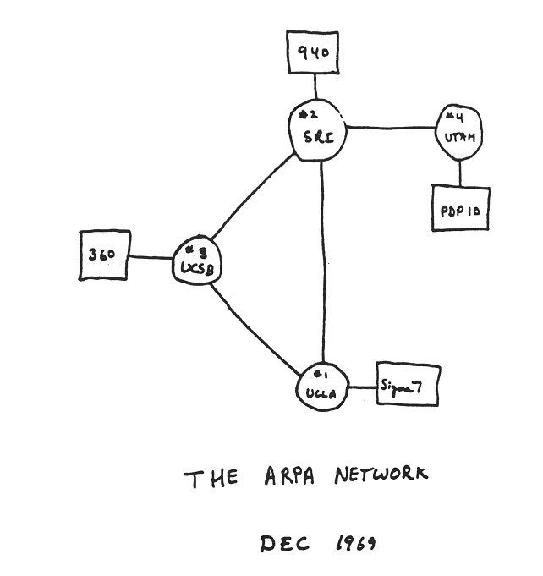
Internet history
1961-1972: Early packet-switching principles
1961: Kleinrock - queueing theory shows effectiveness of packet-switching
1964: Baran - packet-switching in military nets
1967: ARPAnet conceived by Advanced Research Projects Agency
1969: first ARPAnet node operational
1972:
ARPAnet public demo
NCP (Network Control Protocol) first host-host protocol
first e-mail program
ARPAnet has 15 nodes

Slide 84
Internet history
1972-1980: Internetworking, new and proprietary networks
1970: ALOHAnet satellite network in Hawaii
1974: Cerf and Kahn - architecture for interconnecting networks
1976: Ethernet at Xerox PARC
late70’s: proprietary architectures: DECnet, SNA, XNA
1979: ARPAnet has 200 nodes
Cerf and Kahn’s internetworking principles:
minimalism, autonomy - no internal changes required to interconnect networks
best-effort service model
stateless routing
decentralized control
define today’s Internet architecture

Slide 85
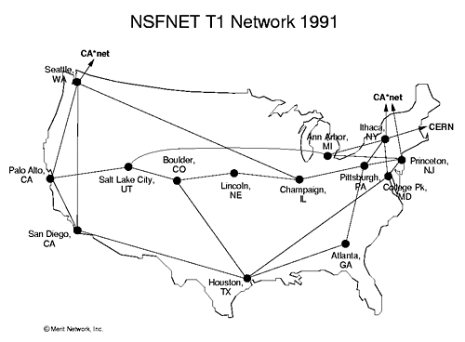
Internet history
1980-1990: new protocols, a proliferation of networks
1983: deployment of TCP/IP
1982: smtp e-mail protocol defined
1983: DNS defined for name-to-IP-address translation
1985: ftp protocol defined
1988: TCP congestion control
new national networks: CSnet, BITnet, NSFnet, Minitel
100,000 hosts connected to confederation of networks

Slide 86
Internet history
1990, 2000s: commercialization, the Web, new applications
early 1990s: ARPAnet decommissioned
1991: NSF lifts restrictions on commercial use of NSFnet (decommissioned, 1995)
early 1990s: Web
hypertext [Bush 1945, Nelson 1960’s]
HTML, HTTP: Berners-Lee
1994: Mosaic, later Netscape
late 1990s: commercialization of the Web
late 1990s – 2000s:
more killer apps: instant messaging, P2P file sharing
network security to forefront
est. 50 million host, 100 million+ users
backbone links running at Gbps

Slide 87
Internet history
2005-present: scale, SDN, mobility, cloud
aggressive deployment of broadband home access (10-100’s Mbps)
2008: software-defined networking (SDN)
increasing ubiquity of high-speed wireless access: 4G/5G, WiFi
service providers (Google, FB, Microsoft) create their own networks
bypass commercial Internet to connect “close” to end user, providing “instantaneous” access to social media, search, video content, …
enterprises run their services in “cloud” (e.g., Amazon Web Services, Microsoft Azure)
rise of smartphones: more mobile than fixed devices on Internet (2017)
~18B devices attached to Internet (2017)

Slide 88
Chapter 1: summary
We’ve covered a “ton” of material!
Internet overview
what’s a protocol?
network edge, access network, core
packet-switching versus circuit-switching
Internet structure
performance: loss, delay, throughput
layering, service models
security
history
You now have:
context, overview, vocabulary, “feel” of networking
more depth, detail, and fun to follow!

Slide 89
Additional Chapter 1 slides

Slide 90

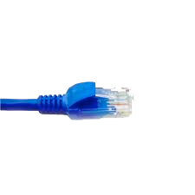
Wireshark
application
(www browser,
email client)
packet
analyzer
application
OS
packet
capture
(pcap)
Transport (TCP/UDP)
Network (IP)
Link (Ethernet)
Physical
copy of all Ethernet frames sent/received

